Slide 1

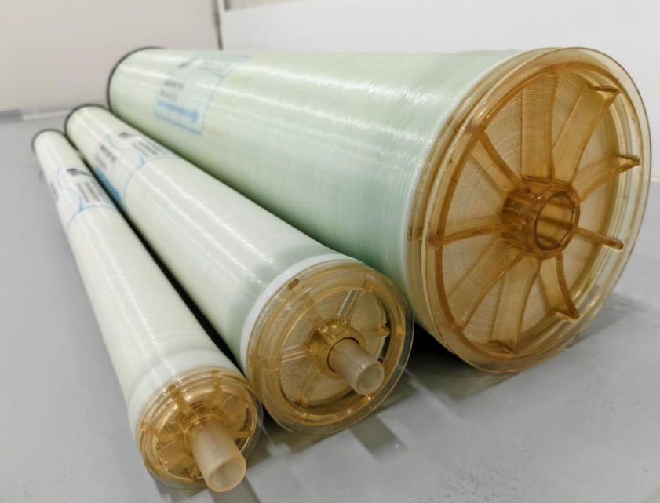
AC-NF-8040
Acid-Resistant NF Membrane Element
Introduction
The acid-resistant industrial nanofiltration series (AC-NF) is independently developed by Cooperate Technology for selective special separation. Adopting proprietary membrane material manufacturing technology, this series enables long-term and stable operation under extreme acidic conditions. The membrane elements can withstand harsh acidic media including 20% H2SO4, 20% HCl, 5% HNO3, and 30% H3PO4.
Application
Hydrometallurgy / Non-ferrous Metals Industry
Waste acid recovery and Acid Washing Industry
Fine Chemicals & Pharmaceutical Intermediates
The electronics and Surface Treatment Industry
Separation of special chemical materials
Parameters
Model | Typical Stabilized Salt Rejection (%) | Minimum Salt Rejection (%) | Permeate Flow Rate GPD（m³/d） | Area ft² (m²)
AC-NF-8040 | 96.0 | 95.0% | 6500 (24.6) | 365 (33.9)
Test Condition
Test Solution | Tem.（ ℃） | pH | Pressure psi (MPa) | Recovery（%）
2000mg/L MgSO₄ | 25 | 7.0 | 110 psi (0.76MPa) | 15
Test Condition: 2000mg/L MgSO₄, 110 psi, 25℃, pH7
Flow rates for individual elements may vary but will be no more than ±15%
Active area guaranteed ±3%

Slide 2
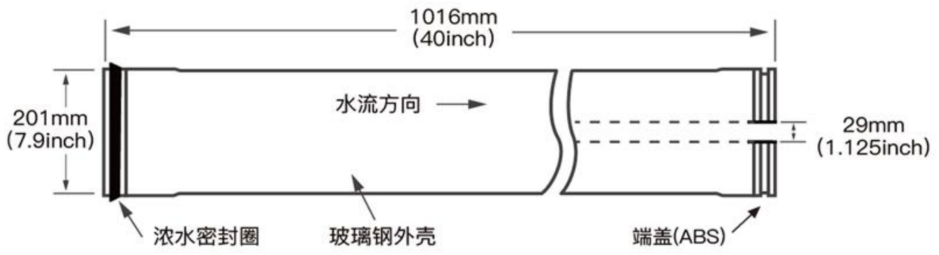
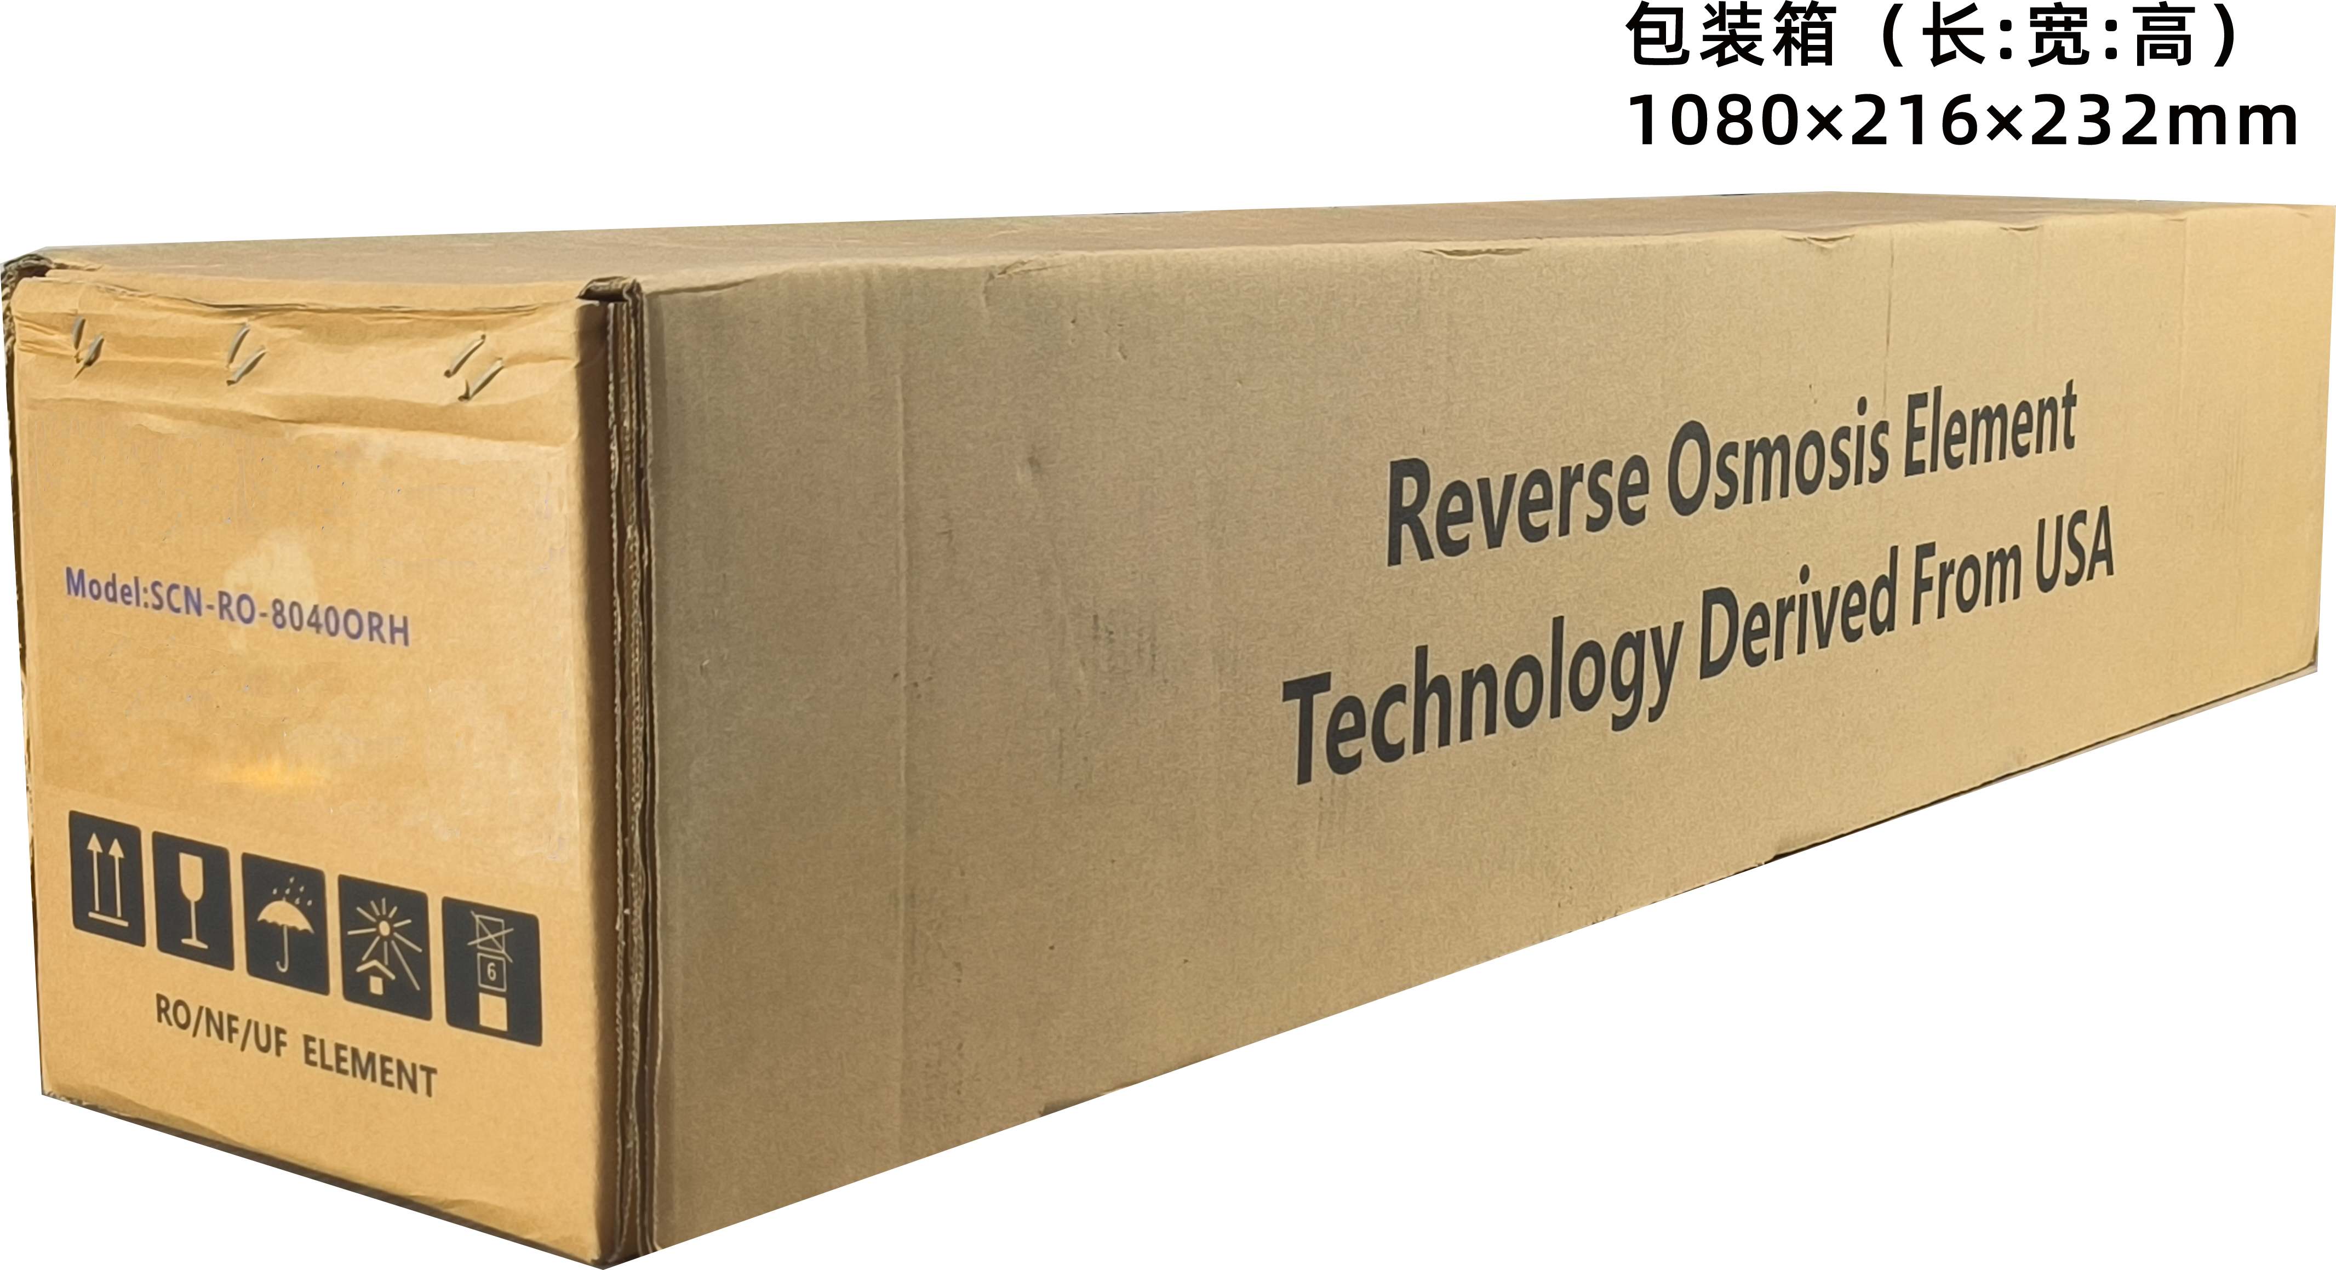
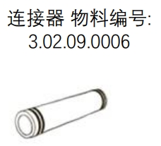
Using Conditions
Maximum Operating Pressure | 600 psi(4.14MPa)
Maximum Operating Temperature | 60 ℃
Maximum Feed Flow | 75GPM (17m³/h)
Maximum Feed Silt Density Index (SDI) | 5.0
Application Environment (Acid) | 20% H2SO4, 20% HCl, 5% HNO3, and 30% H3PO4.
Short-Term Cleaning (30 min.) pH Range | 1-13
Maximum Pressure Drop Per Element | 15psi (0.1Mpa)
Cautions
When the membrane element is first used, the water produced during the first hour should be discharged and not used.
When the membrane element is manufactured, the dry type membrane element has no protective liquid. Once the element gets wet, it should remain in a moist state.
The feed water pressure should be gradually increased within a time range of 30-60 seconds. Otherwise, it may cause irreversible damage to the membrane element.
At any time, back pressure on the water production side should be avoided.
The wet type membrane element is tested with water before leaving the factory, and is stored with a 1.5% sodium bisulfite solution (in winter, 10% propylene glycol antifreeze solution needs to be added). Then it is vacuum-packed.
When the system is shut down for a long time, to prevent the growth of microorganisms, it is recommended to immerse the membrane element in a 1.5% (by weight) sodium bisulfite protective liquid and replace the protective liquid regularly.
Users must strictly follow the operation limits and rules set in this manual. Otherwise, the company will not bear any consequences arising therefrom.
Users are strictly prohibited from using any chemical substances that are destructive to the membrane element during storage and operation. If such chemical substances are used, the company will not bear any consequences arising therefrom.
Dimensions and Packaging
Package Size: 1060*130*130 mm
Connector material code
99mm
4inch
Flow
19mm
0.75inch
Seal ring
Seal ring
FRP shell
End cap ABS

